Slide 1

Determining the charge of the calcium ion in calmodulin using machine learning.
-Nate Jennings

Slide 2
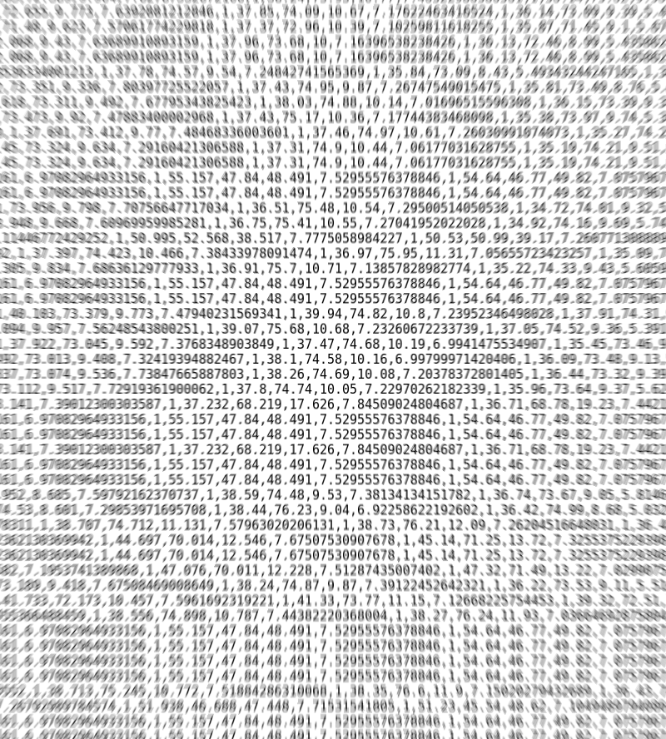
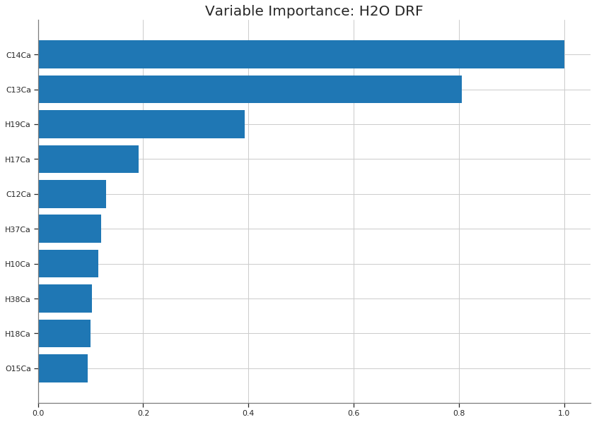
Challenges and Limitations
Quantum calculations currently take 8 hours a frame on unoptimized structures.
Optimizing the tradeoff between the amount of data and its physical accuracy.
Without ample good data, no amount of teaching the machine will make it learn better.
A shared scratch solves a few issues with runtime and volume of data.

Slide 3
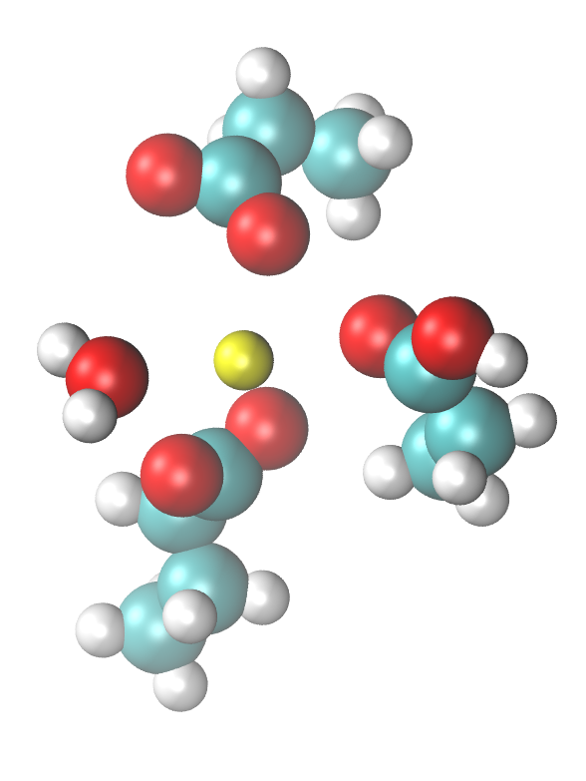
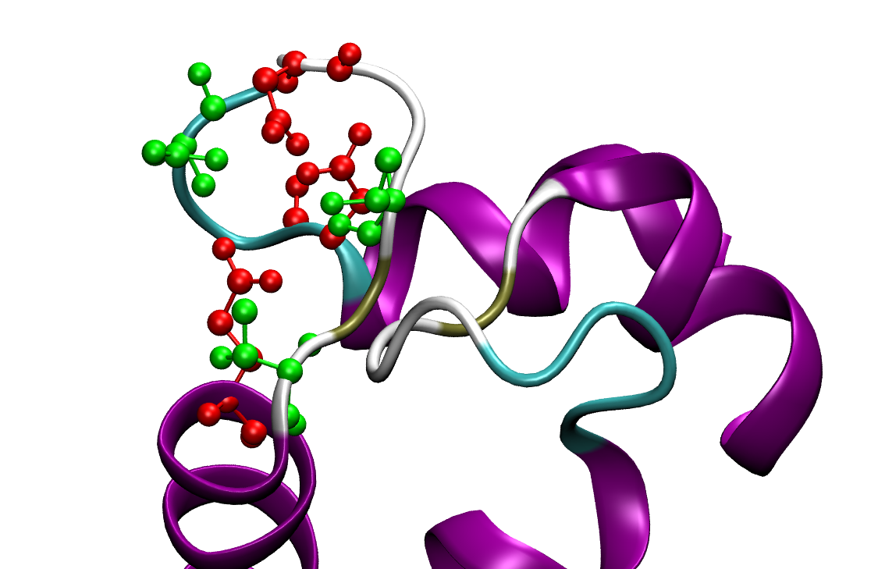
Model and Input
2
2
DDDTTE
20 22 24 26 28 31
1
1
3
3
Only three of the six most important residues are included without backbone.
Future simplifications will focus on individual important atoms instead of residues to include more information.

Slide 4
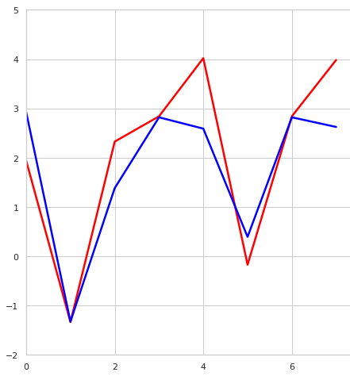
Idea and Goals
Machine learning can potentially estimate quantum chemistry calculations.
Fill in for the computationally expensive calculations in scenarios like all-atom or course-grained MD simulations.
Need to be accurate enough that thermal fluctuations do not distinguish the quantum chemistry charges from the machine learning guesses. Maintain physical accuracy.
Predicting 8 charges from a training set of 64. With an R2 of 0.76, machine learning shows promise to predict physically accurate charges.

Slide 5
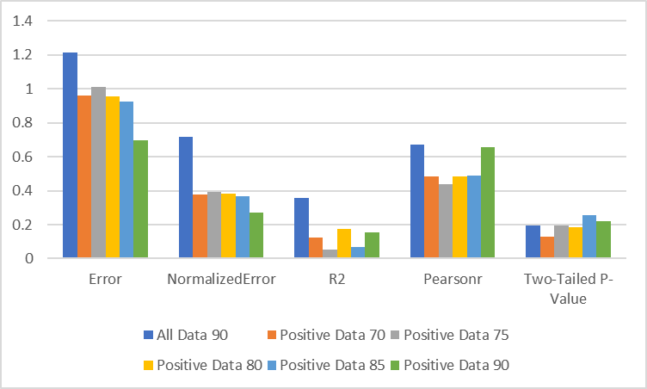
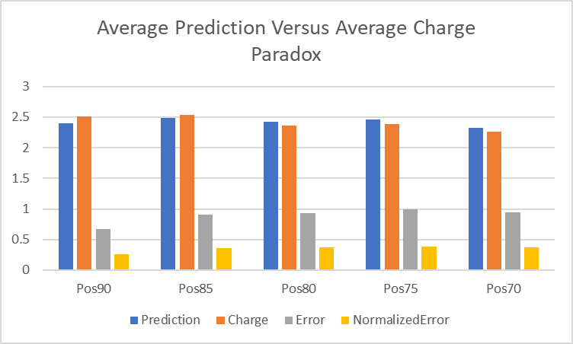
Current Results
Individual models
Sets of models
Limited by the size of the training set, in the best cases current errors are about 0.7 e, 25% of calculated charge.
Clear increase in performance is shown as the size of the training set increases.
Paradoxically, large errors quickly average out, indicating a potential for many-frame applications.

Slide 6
Real Model Accuracy
Positive-restricted training data gives unphysical predictions for real models while using all the data to train gives accurate results.
Charge validated by Lepšík, Martin, and Martin J. Field to be 1.77 in P. tetraurelia.
No prediction was negative and very few were over two.
In contrast, positive-restricted data was always above 2.

Slide 7
Plans for the future.
Data collection
Machine Learning
Increase the proportion of important atoms in the simplified model.
Reduce remote atoms
Promote a full chemical environment around Ca²⁺
Optimize structures before calculations
More data
Experimentation with different techniques
Deep learning
Principal Component Analysis
Clustering methods
K-means
Other algorithms

Slide 8
People
Pengzhi Zhang
Jaebeom Han
Pablo Rondon
Piotr Cieplak
Dr. Cheung
Nate Jennings

